Slide 1
IP Addressing- I
Course Code: CSC 3116
Course Title: Computer Networks
Dept. of Computer Science
Faculty of Science and Technology
Lecturer No: | Lab 1 | Week No: | 1 | Semester: | Summer 23-24
Lecturer: | Md. Faruk Abdullah Al Sohan; faruk.sohan@aiub.edu

Slide 2
Lecture Outline
Classification of Address
Conversion from binary to decimal and vice-versa
Range of Address

Slide 3
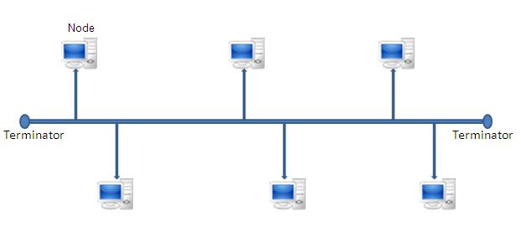
How to identify the recipient?

Slide 4
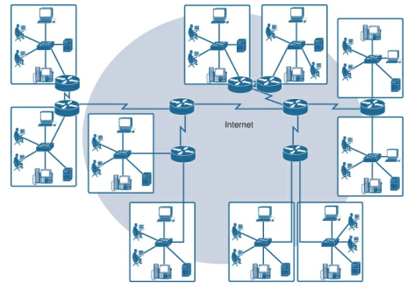
How to identify the recipient? (contd…)
Receiver
Is single address
enough for both LAN
and collection of
networks?
Sender

Slide 5
Classification of Address
Address
Physical Address
Logical Address
Port Address

Slide 6
Physical Address
The address of a node as defined by its LAN
The lowest-level address
The size and format of these addresses vary depending on the network
Ethernet uses 6 bytes address (imprinted on Network Interface Card (NIC)

Slide 7

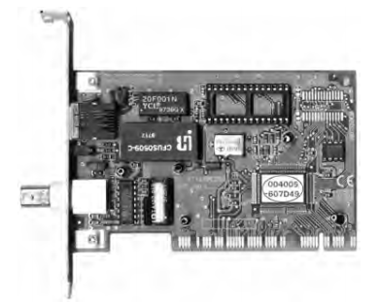
Physical Address (contd…)
6-byte address is also called Medium Access Control (MAC) address
No two NICs ever share the same MAC address
Either imprinted on the surface or burnt into a ROM chip
CA1885-0CB72C
CA-18-85-0C-B7-2C
Organizationally
Unique Identifier
Network Interface Card
Device ID

Slide 8
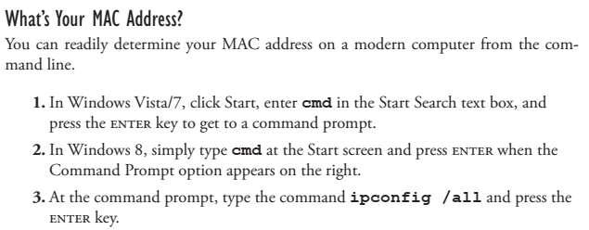
Physical Address (contd…)

Slide 9
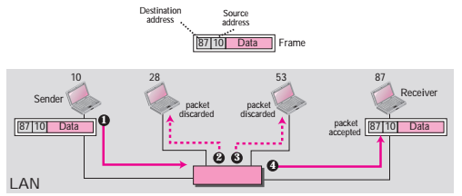
Physical Address (contd…)
Use of Physical Address

Slide 10
Logical Address
Physical address is not suitable for internetwork as different networks can have different address formats
A universal addressing system is needed in which each host can be identified uniquely, regardless of the underlying physical network
Can be changed depending on the network
No two publicly addressed and visible hosts on the Internet can have the same logical address (widely known as Internet Protocol (IP) address.
32-bits length

Slide 11
Port Address
Used to identify a process (Email, FTP)
16-bits length
Internet Assigned Number Authority (IANA) assigns Port address

Slide 12
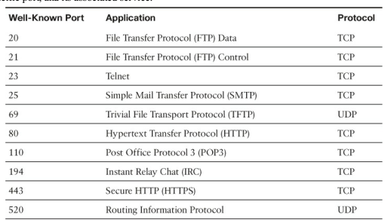
Port Address

Slide 13
Binary-to-Decimal Conversion
For addressing, we require
to convert a 8-bits binary to decimal
To convert a decimal number of up to 255 to binary number
Digit | x₈ | x₇ | x₆ | x₅ | x₄ | x₃ | x₂ | x₁
Position of digit, i | 8 | 7 | 6 | 5 | 4 | 3 | 2 | 1
Contribution of the digit, 2^{i-1} | 2⁸⁻¹ | 2⁷⁻¹ | 2⁶⁻¹ | 2⁵⁻¹ | 2⁴⁻¹ | 2³⁻¹ | 2²⁻¹ | 2¹⁻¹
Decimal contribution | 128 | 64 | 32 | 16 | 8 | 4 | 2 | 1

Slide 14

Binary-to-Decimal Conversion
$$if x_{i}=1, add 2^{i−1} to the sum$$
$$for ∀i$$
Digits | 1 | 0 | 0 | 1 | 1 | 0 | 0 | 1
Position | 8 | 7 | 6 | 5 | 4 | 3 | 2 | 1
Contribution | 128 |  |  | 16 | 8 |  |  | 1
128+16+8+1=153
(10011001)₂=(153)₁₀

Slide 15
Binary-to-Decimal Conversion
0 | 1 | 0 | 0 | 1 | 1 | 0 | 1
Digits | 0 | 1 | 0 | 0 | 1 | 1 | 0 | 1
Position | 8 | 7 | 6 | 5 | 4 | 3 | 2 | 1
Contribution |  | 64 |  |  | 8 | 4 |  | 1
64+8+4+1=77
(01001101)₂=(77)₁₀

Slide 16
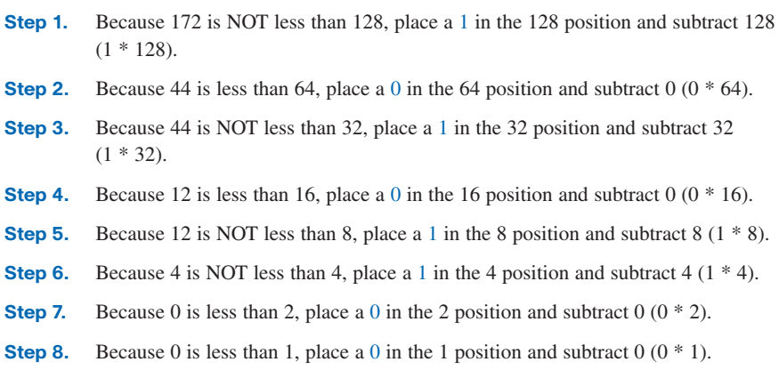
Decimal-to-Binary Conversion
(172)₁₀ =( )₂
(172)₁₀ =( 10101100)₂

Slide 17
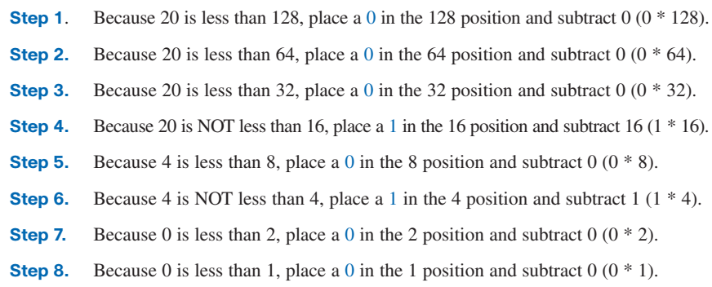
Decimal-to-Binary Conversion
(20)₁₀ =( )₂
(20)₁₀ =( 00010100)₂

Slide 18
Decimal-to-Binary Conversion
Convert the following:
210, 50, 65, 172, 169
11001010, 11100001, 10101111

Slide 19

IP Address
IP=Internet Protocol
Unique and universal
32-bit binary address
Divided into four octate
Octets are separated by dot (.) sign
Address space
Total number of address used by a protocol
For b bits, the address space is 2^{b}
10000000000010110000001100011111
10000000 00001011 00000011 00011111
Octet
IP Address
10000000.00001011.00000011.00011111
Doted Decimal of IP address
128.11.3.31

Slide 20


IP Address
Example
Example

Slide 21
IP Address
Example
192.168.10.25
16.32.25.31
78.123.222.44
11110000.10101010.11100011.00011100
10001000.10010011.11100000.00000110
Example

Slide 22

IP Address
Example

Slide 23
Ranges of Address
Example
Solution
Example
Solution

Slide 24
References
1. Official Cert Guide CCNA 200-301 , vol. 1, W. Odom, Cisco Press, First Edition, 2019, USA.
2. CCNA Routing and Switching, T. Lammle, John Wily & Sons, Second Edition, 2016, USA.
3. Cisco IOS Configuration Fundamentals Command Reference.
http://www.cisco.com

Slide 25
Books
1. Official Cert Guide CCNA 200-301 , vol. 1, W. Odom, Cisco Press, First Edition, 2019, USA.
2. CCNA Routing and Switching, T. Lammle, John Wily & Sons, Second Edition, 2016, USA.

